Slide 1
STROKE RISK ANALYSIS

Slide 2
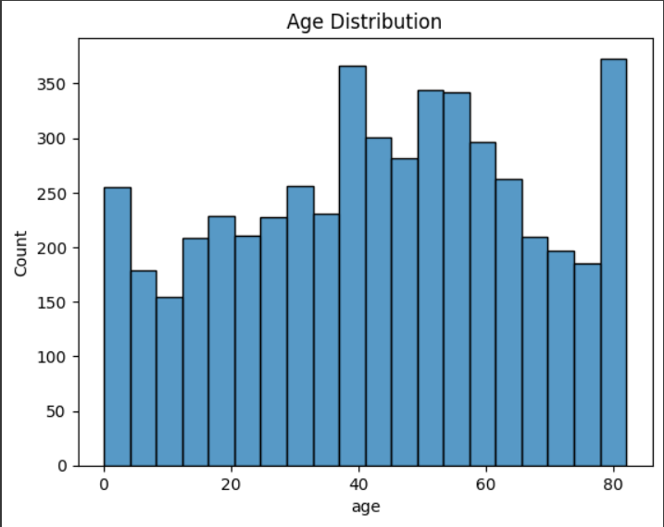
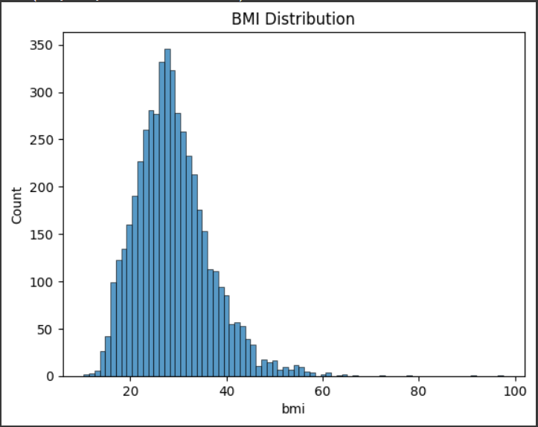
UNIVARIATE ANALYSIS

Slide 3
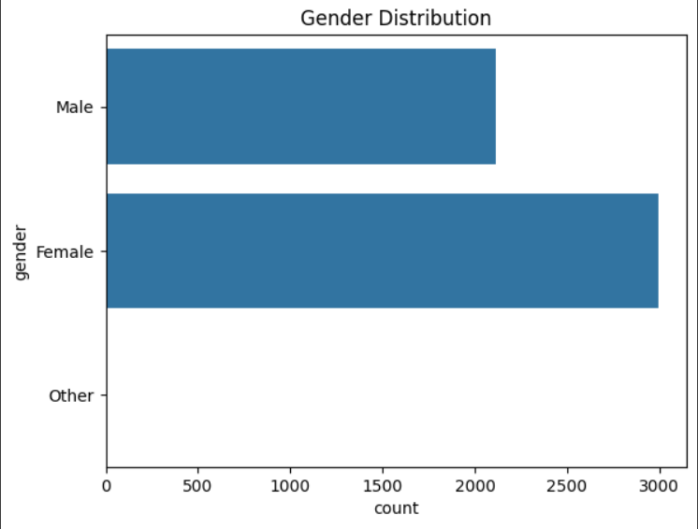
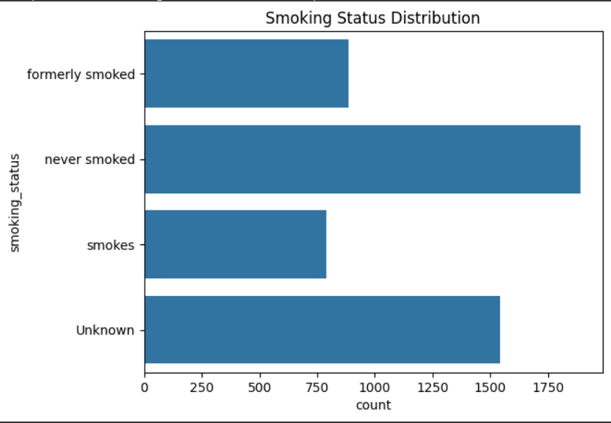

Slide 4
Univariate Analysis
Age: Spread across 0–80+; peaks at 35–40 and 80+
BMI: Right-skewed; most between 20–35; peak at 27
Gender: More females than males
Smoking Status: Most never smoked; many entries are ‘Unknown’

Slide 5
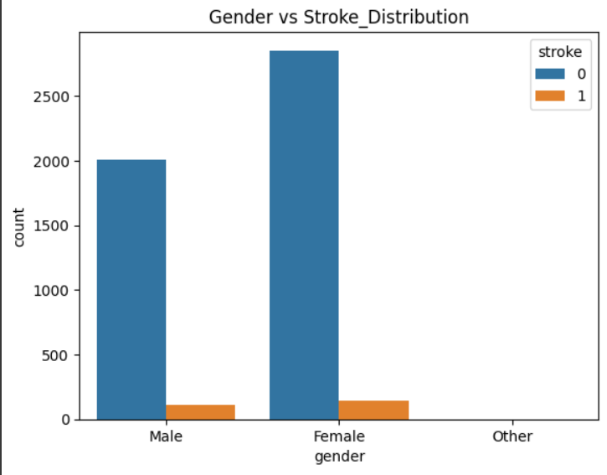
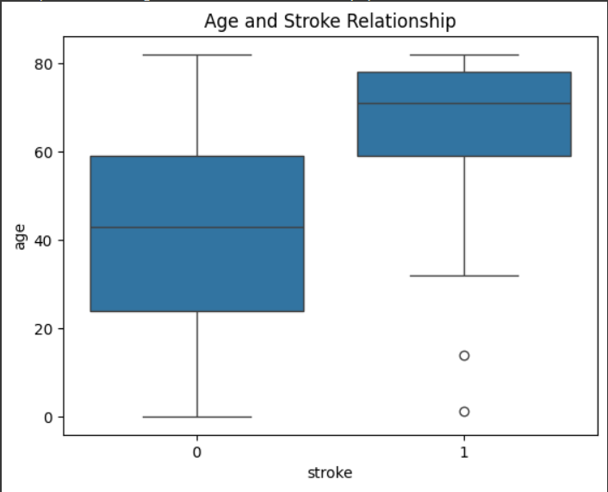
BIVARIATE ANALYSIS

Slide 6
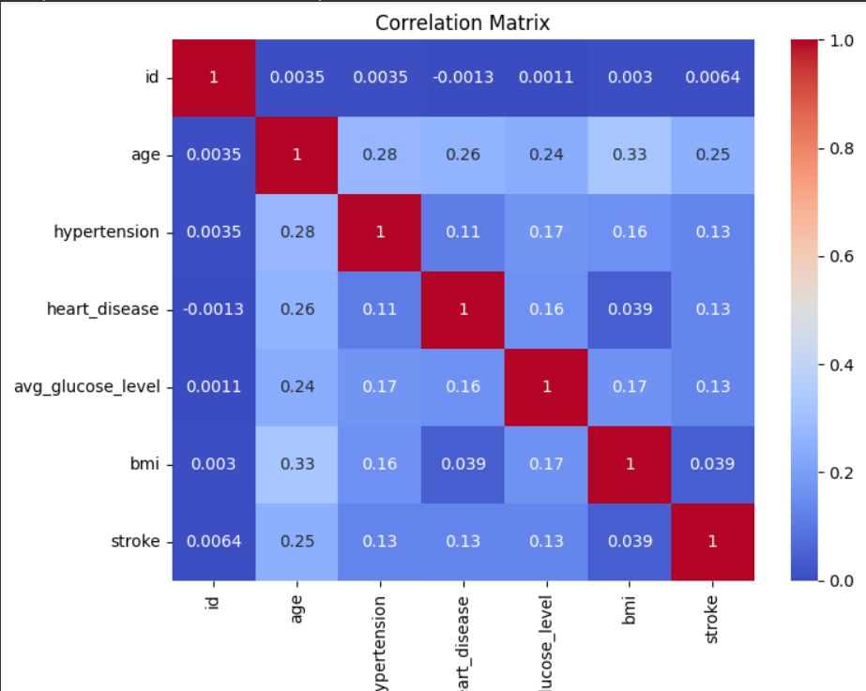
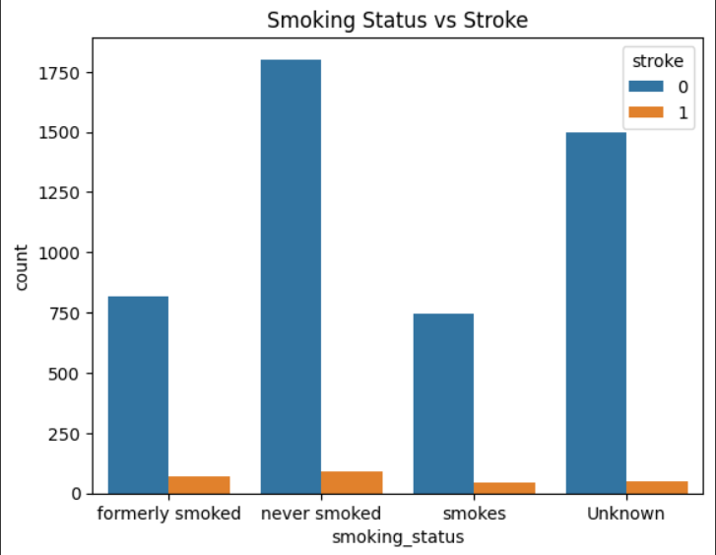

Slide 7
Bivariate Analysis
Gender vs Stroke: Slightly more strokes in females; overall stroke rate is low.
Age vs Stroke: Older people (~70+) more likely to have strokes.
Smoking vs Stroke: Strokes found in all groups; more in ‘formerly smoked’ and ‘never smoked’.
Correlation: Age has the strongest link to stroke; other features have weak correlation.

Slide 8
Overall Insights
Age is the strongest risk factor for stroke – older individuals (especially 60+) are more prone to strokes.
Most patients have never smoked, but stroke cases still appear in all smoking categories, suggesting other factors matter more.
BMI is moderately skewed, with most values in the overweight range (20–35), which may contribute to stroke risk.
Stroke occurrence is rare overall in the dataset, making it an imbalanced classification problem for machine learning.
Weak correlations between stroke and other variables (like heart disease, hypertension, BMI), but age stands out clearly in both univariate and bivariate analysis.

